Slide 1


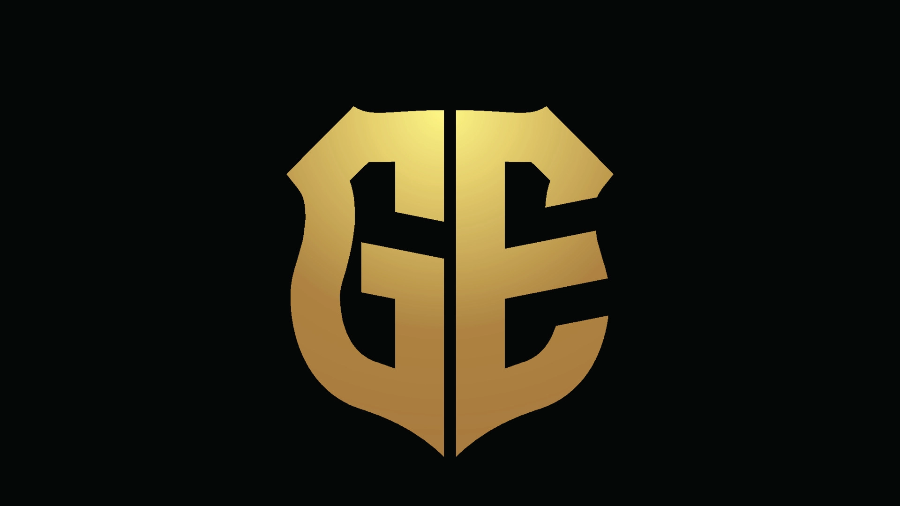
Grand exchange
The blockchain-based game marketplace
(danangmulyo01798, 2021)
Notes:
My project is the Grand exchange. It is a blockchain based game marketplace

Slide 2
Introduction
Playing platform
Grand Exchange
Games
The Grand Exchange will be a place where all in game purchases can be together in one place.
The goal is to connect the game accounts and marketplaces together into one full place where it can all be done.
Notes:
The idea is to be a one stop market for all game related transactions. This is done by making a connection between the player and the game they are playing where they can trade on.

Slide 3
Advantages of blockchain-based marketplace
Distributed database instead of common database to reduce maintenance cost and allow all places to store the database related to them.
More transparency as no central governance so all points can adopt own rules for their space.
Faster and lower cost transaction. Without the middleman they will all become direct transactions with no extra parties needed.
Ease in adding new markets as fully integrate right away.
More privacy and security as all transations are instantly encrypted into the blockchain ledger
(DA14, 2018) (Anderson, 2022) (Science Soft, 2022)
Notes:
The advantages of this over a regular market is that there will be no central point needing to run and manage it. This allows all the nodes to store their own database cutting down on the costs of running the service as well as making the transactions cheaper too cause of no middle man.
With no central point there will be more transparency and allow each node to make their own rules on how they want to run their market.
The ability to easily add in new marketplaces in here and have them fully intergrate with ease. This doesn’t impact the rest of network too.
Also, with it using a blockchain for transaction privacy and security becomes super tight. As all transaction get encrypted straight away.

Slide 4
What does this aim to solve
Grand Exchange aim is to more seamlessly integrate the third party marketplaces into the games they are selling from. As currently you have to go out of game for these markets and with the games not being involved in this problems often arise. A lot of games like Hypixel Skyblock have explicit rules against IRL trading as would often lead to scams. So if the games were instead involved in this they could add their moderation to their market and would then get the security from the game backing it. Also with integrated into the game more options now become available to go into.
Notes:
The goal of grand exchange is the improve how people currently have to trade items from games. As currently the most used methods are mostly third party sites with no build in connection to those games.
Also, a lot of games have explicitly banned IRL trading as it often lead to easy scams or the items traded were often hacked in. so if the games were more involved in the trading it would add more a level of security on the trades and stop people getting banned because they had no good way to do this.

Slide 5
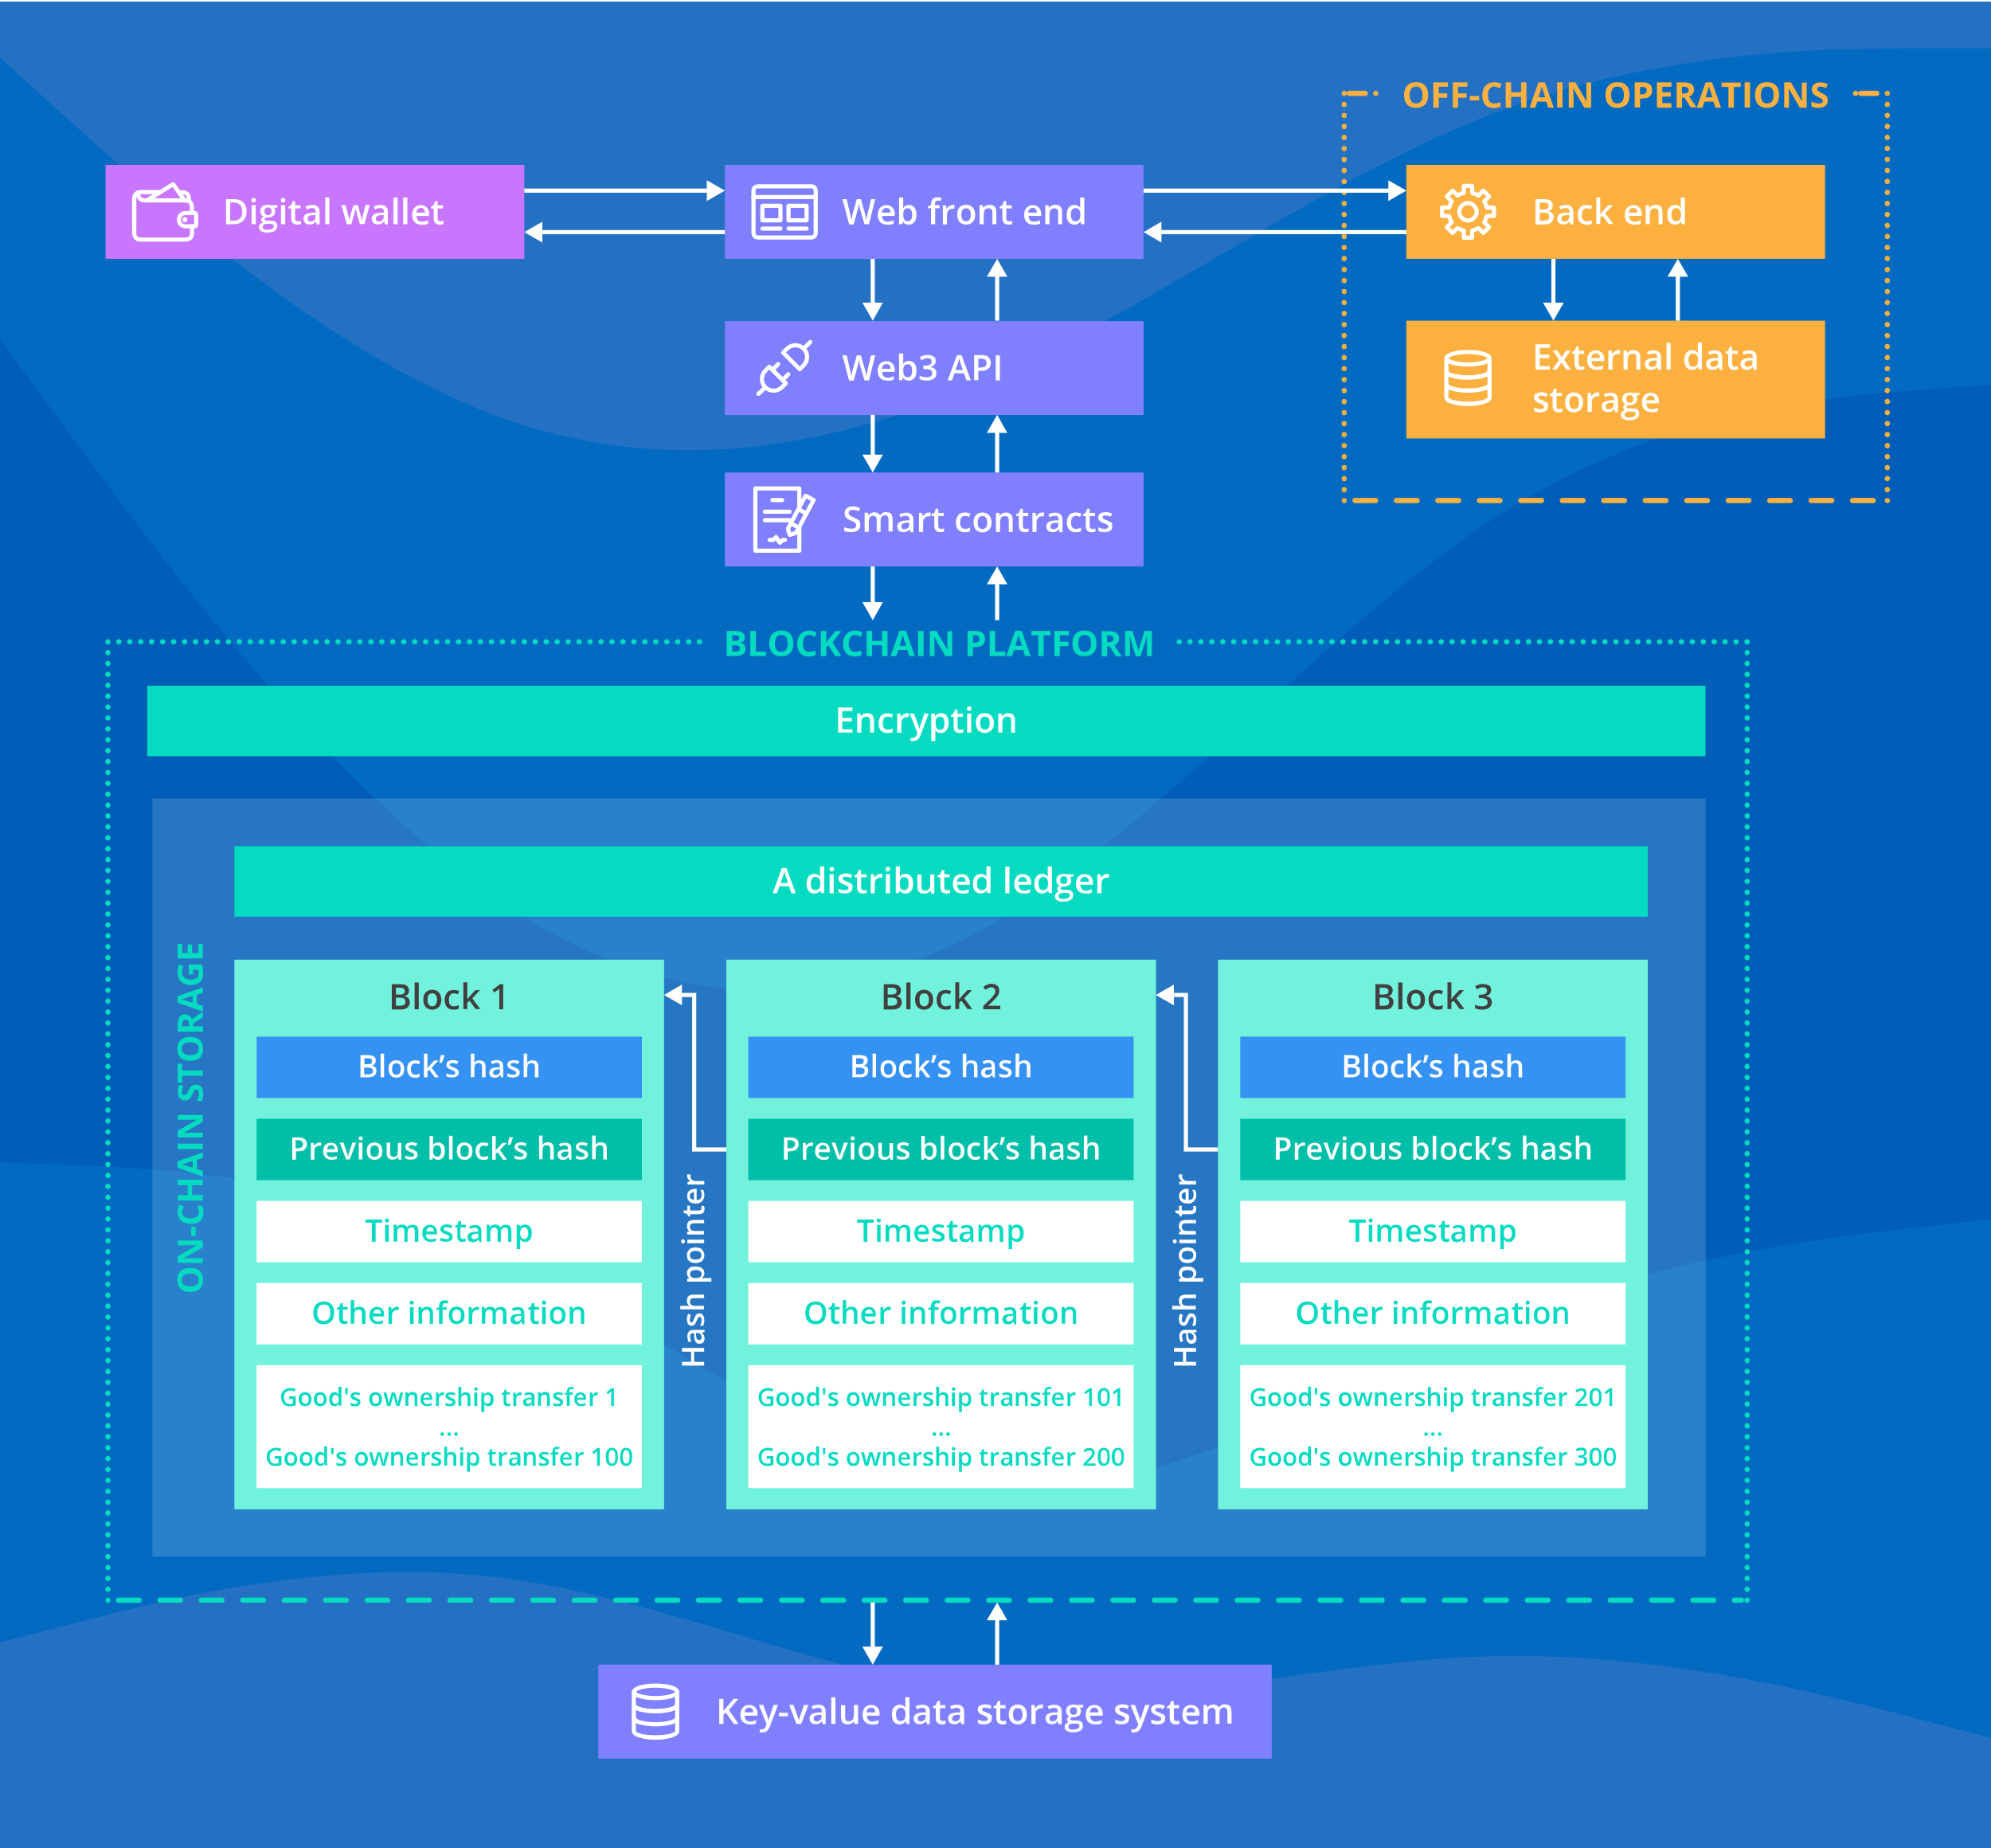
How it will function
Game
Playing Platform
This will work by adding another layer to the chart from Science Soft. Where the game and platform are connected to the web front of Grand Exchange.
This will work as the transition hub between the two parties. Using smart contracts on all activities on the network.
(Science Soft, 2022)
Notes:
This will function similar to the example marketplace from science solf but will add another layer to it.
We will add the connection to the game and player where the site will act as the trading hub for them.

Slide 6
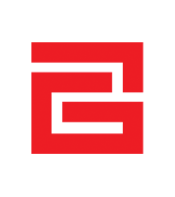
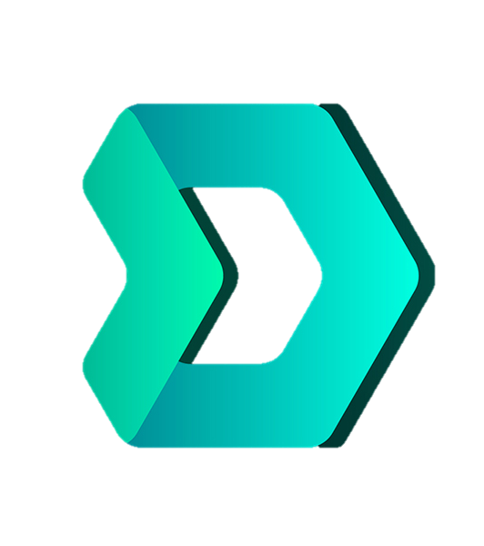
The current way
Currently there are places to do this such as G2G and Dmarket. However, there are issues with them being separated from the games they are marketplaces for. This would require more trust now and with games not being involved the companies often have issue with them. Often bans have happened from these things or items get voided
(DMarket, 2022)
(G2G, 2022)
Notes:
Currently there are a few marketplace out there for game items but they have limitations. G2G is a third party site separate from the games it trades with meaning more trust is now needed. Also with games not being connected to G2G bans are quite possible or having the item voided.
While Dmarket is also a blockchain based marketplace that is connected to a few games. But this is only a few of them.

Slide 7
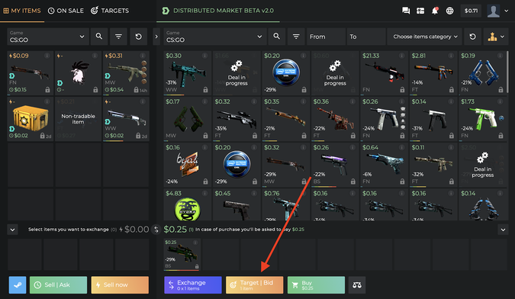
The competition
Dmarket is also a blockchain-based game marketplace that works with the game companies to allow for item (mostly just skins) trades. This currently has 8 games on the marketplace and an easy way for game developers to add their games to it with custom APIs for it. However, there are a lot of games that it is still missing which other third-party marketplaces sell. So, there is still quite a bit of space to compete with it. Also, the adoption of this type of market is still quite a new thing so hasn’t been fully established in the space.
So Dmarket would be possible to use a template for how to do it and where possible improvements can be made as the world of blockchain-based markets increase.
(Takahashi, 2020)
(DMarket, 2022)
Notes:
Dmarket is the biggest competitor in this market. They were established back in 2017 and in 2020 they started taking off with new leadership and funding.
They however only have 8 games that is linked in them to the game companies. Leading to a largest gap in market to jump into with the games they are missing.
With their simple API they can easily add in new marketplaces from games but seems places are still holding off on that for now. Likely from this still being reasonably new tech they are using that has still yet to win over other companies.
So now is still a good time to get in on that competition as there is a big gap to fill and we can use Dmarket as a template for what works to do.

Slide 8
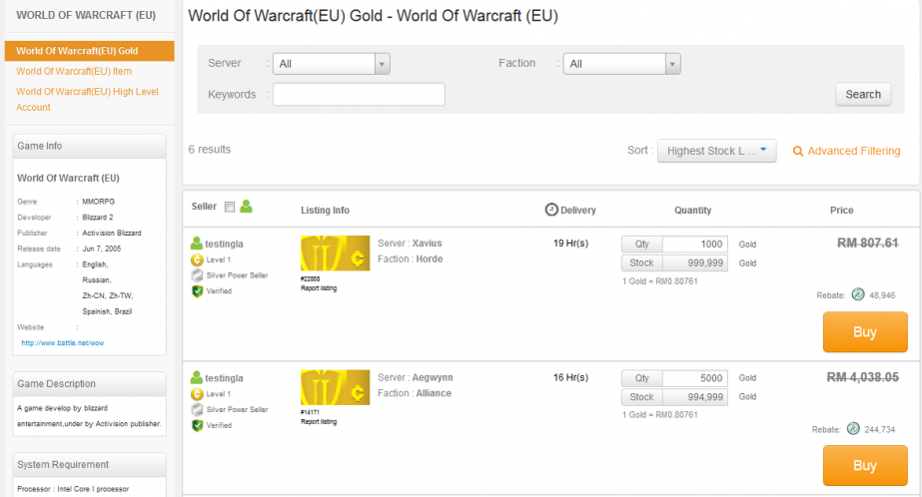
How to stand out
By adding the games that Dmarket is missing we will be able to take advantage of the vacuum in those games for no blockchain market there. As in most games the only option is the third-party sites like G2G and igitems. These are separated from the games they trading with unlike Dmarket so gamers would be welcoming if we could integrate them with the games.
(G2G, 2022)
Notes:
To then standout in this area we will go after the game that are missing an integrated marketplace where only places like G2G and igitems are sitting. So by being the blockchain based market there we will have an advantage over the other third party sites so should be able to get people from there moving over to us.

Slide 9
Potential issues
The biggest issue to start would be establishing ourselves in this place to get people wanting to use us.
Trying to convince the game company's to use us to integrate their markets and why it would benefit them.
The cost to set up enough of the network before people are even able to use it as a lot of back-end stuff is needed to get this project running.
Notes:
The potential issues with this will be to establish ourselves as a place worth trading on. Then trying to get the companies interested is joining use to make the improved marketplace. And finally getting the funds to set up enough of the network to make it useable for players and companies.
This part will likely be hardest as Dmarket took 2 years to get the funding for their big expand.

Slide 10
Target users
The initial target user base would be the people already using the third-party marketplaces that are available. Later the idea is to expand to more types of game to be the go-to place for all buy/selling of in-game things.
This would start with more hardcore gamers playing MMO type games and later go into the casual gaming market.
Notes:
The users we will target here are the more hardcore users that already use such sites as these. Starting with whichever game we can get onboard first. This will mostly be the big MMO games to be there trade hub.
Later we want to get in more casual players like the mobile game players.

Slide 11
Why this needs a block chain?
The state of the marketplace needs storing as it will always be changing due to transactions happening.
Multiple companies will be their own personal market as a node on the grand exchange network.
No trusted third part can be used as idea this will remove the main function of us in providing universal platform to exchange.
So as we can not make trust for all users and needs to be verified for transactions so will use a permissionless blockchain as companies controlling market nodes will only need same trust as normal users.

Slide 12
Laws surrounding the marketplace
This is a marketplace using a different companies API to interact with so will have to follow the rules those companies have for their services. Also, with the fact that monetary transactions are happening the laws around those will have to be followed. But as we aren’t handling those personally ourselves that will be more on the company controlling those markets to manage those laws. We will have to provide the necessary tools to follow those law for the companies on here though. For grand exchange itself there seems to almost no regulations in place limiting us with the markets as decentralised markets are still such a new concept that laws have not caught up and doesn’t have a central control so isn’t in any country. Though the companies themselves will have laws governing them that have to be followed. A big set of regulations this will however have to follow is trusted practices. We will have to make things as transparent as possible so all users can know how it works and if it is worth trusting as a marketplace.

Slide 13
Regulations related
As the marketplace exists as a decentralised model there will be no central governing body controlling it. This makes the regulation on what we can do be more along the lines of trust in us. We need the users and companies to be comfortable using us as we handle all the backend payments with the ledger and transactions between users. So the use of common business practices will be needed and we will need to prove the tools the companies will need for their markets.
(Dayal, 2021)

Slide 14
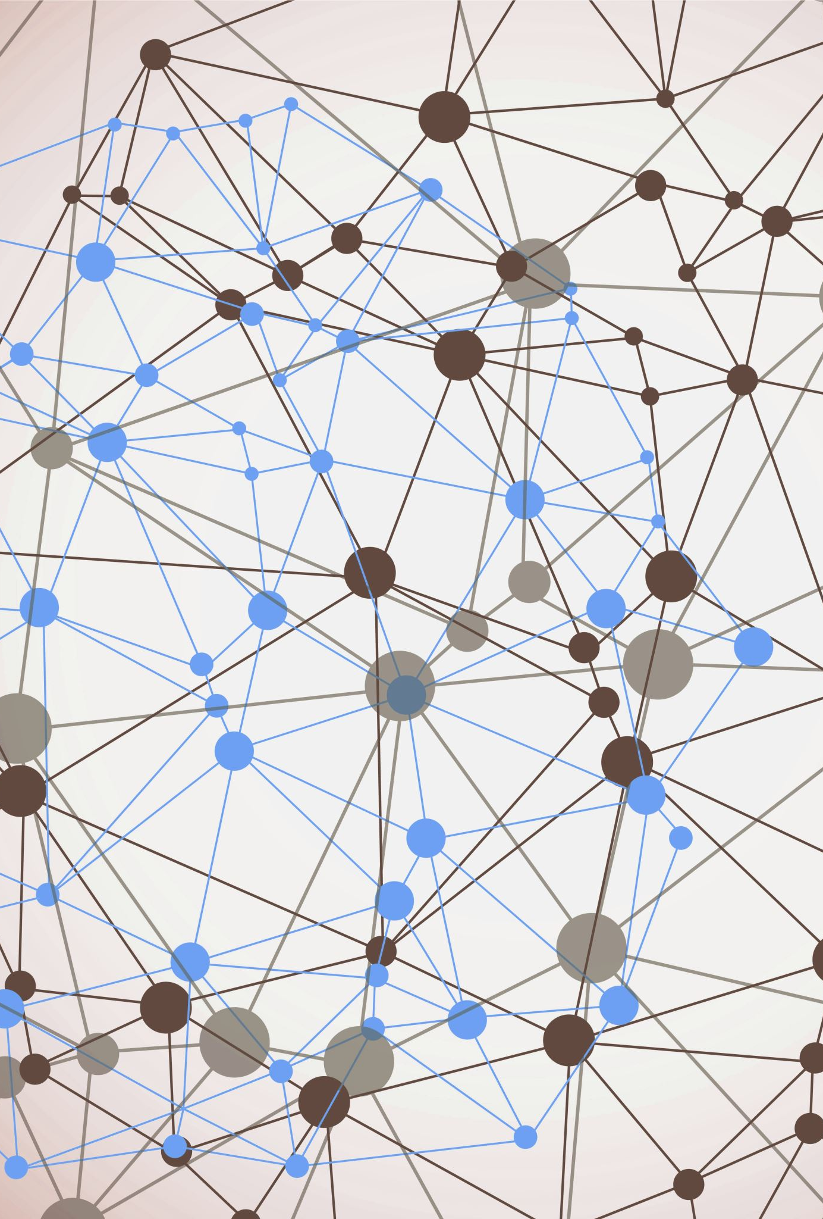
Critical making
With the whole idea of decentralisation becoming such a kind of buzz work now, actually putting it into practice becomes a unique problem. We have all these great concepts of wanting to have no central control and Grand Exchange does want this too, but a lot can only stay as a concept for now. However, I want to bridge the gap between concept and reality with this so you can get all the benefits of a marketplace connected to the big companies while also still having the freedom that comes from no central control. To do this the idea of having each different market being separate solves most of this. Allowing the companies to control their part while also not needing a governing body to control the whole thing. In the prototype I have an example of a company’s marketplace they could run there where they can do whatever they want. While Grand Exchange will only act as the place to do the transactions over and make the infrastructure needed to facilitate this.
(Hertz, 2022)

Slide 15
The Three Paradigms of HCI
The three paradigms can be used to help making Grand Exchange. The first one can be show us that a simple option is often the best way to do it. From this we see that when setting up the network we want ease for all involved. For this we need to make adding to the network as easy as possible and make ways to reduce the errors. For this we can make templates of markets that can show all possible functionality we have available. For the users we will make adding their items simple with the use of game platform APIs to grab the information on the item, so all the user needs to add is the price they want.
The second one fits well into the solution for first as we will make things as generalized as possible so different infrastructure isn’t needed for each market and more time can be placed into improving the main one.
The third is to make all the complex happen behind the scenes. So, the interfaces will look simple as possible while behind all the magic will happen. To implement this, we will work heavily on the user experience and flow to streamline the users process and have a huge amount of interconnection so any information already known will always be available from the blockchain. Also, the use of the APIs will help in this as we can just get what we need from there and what needs to be entered by the users is as little as possible.
(Harrison, 2007)

Slide 16
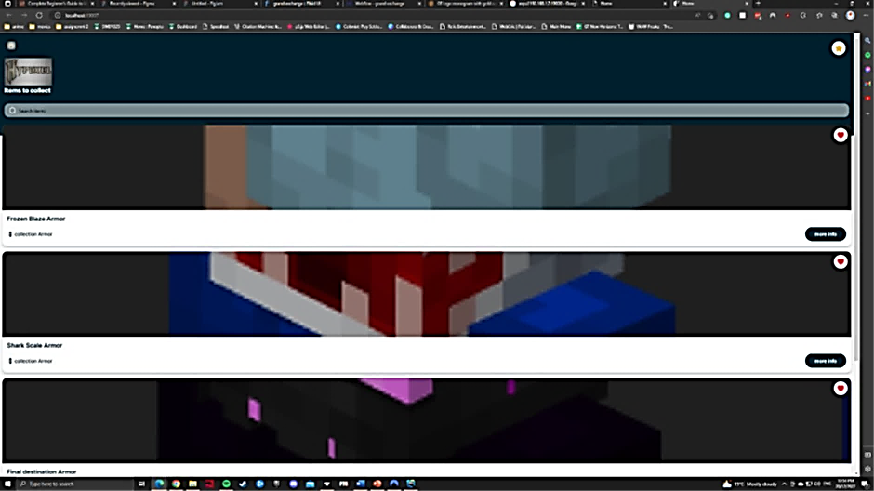
Prototype
henry-g-c-pettit/GrandExchange (github.com)

Slide 17
References
Hertz, G. (2022, December 19). What is critical making? What is Critical Making? Retrieved December 20, 2022, from https://current.ecuad.ca/what-is-critical-making
Harrison, S. (2007, May 3). The three paradigms of HCI - Virginia Tech. The three paradigms of HC. Retrieved December 20, 2022, from https://people.cs.vt.edu/~srh/Downloads/TheThreeParadigmsofHCI.pdf

Slide 18
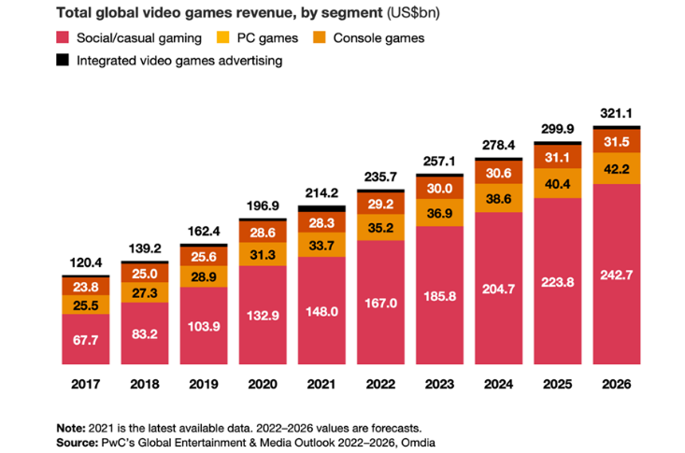
Current gaming trend
Gaming has been booming over the past few years with it becoming more accessible and COVID giving people more of a need for entertainment at home. This is predicted to continue and even with lockdowns being a thing of the past the gaming industry is still expanding. This has even become a more social activity now enticing more people.
(PricewaterhouseCoopers, 2021)
(Read, 2022)
Notes:
Over the last few years a trend of more people playing game on all types of platforms has arisen.
Even with lockdowns being over the trend is still going up. This shows that it should still continue on the rise for years to come with experts from price waterhouse copper who made this graph predicting it to keep going.
So getting into the game industry should continue to be a good idea for years to come.

Slide 19
What is a blockchain marketplace
This is a decentralised e-commerce platform with no central control. This is run and controlled by the users with many servers together. It uses the blockchain to keep the ledger of all transactions and enable the use of crypto currency inside.
(DA14, 2018) (Anderson, 2022) (Science Soft, 2022)
Notes:
A blockchain based market place is a decentralised e-commerce platform that has no central control. It is instead run by the uses as a links group of nodes all going together to make the marketplace.
With it being a blockchain it also allows for the use of crypto currency in it. With all transactions being stores and secured in the blockchain ledger.

Slide 20
Summary
There is competition out there for this type of item but they are not fully established in all areas so can still compete.
we aim to improve the way trading will work in many of the games and get companies involved in it to help it flow better.
With gaming on an upward trend still even after COVID and marketplaces still being a more new thing this is quite an exciting place to get into while its still growing fast with new opportunities opening up in the industry.
Notes:
In summary the competition for this idea was their a while before us but they aren’t fully established there so can still compete well
Next we want to improve how trading operates outside of the games to add security and flow to them.
And last with how gaming is continuing to trend this will stay an exciting place to get into for a long time even after the COVID boom has ended. So are lots of opportunities for us to take.

Slide 21
Thank You
Henry Pettit
(danangmulyo01798, 2021)
Notes:
Thanks for listening

Slide 22
References
DMarket. (2022, November 26). NFT and virtual in-game items metaverse. DMarket. Retrieved November 26, 2022, from https://dmarket.com/
G2G. (2022, November 26). World Leading Digital Marketplace Platform. G2G. Retrieved November 26, 2022, from https://www.g2g.com/
Science Soft. (2022). Home. Decentralized Marketplace. Retrieved November 26, 2022, from https://www.scnsoft.com/blockchain/decentralized-marketplace
DA14. (2018, February 2). THE INFLUENCE OF BLOCKCHAIN TECHNOLOGY ON ONLINE MARKETPLACES. WHAT'S THE FUTURE? DA14. Retrieved November 26, 2022, from https://da-14.com/blog/influence-blockchain-technology-online-marketplaces-whats-future
Anderson, Y. (2022, August 25). What is the blockchain marketplace and how to start one. eCommerce Blog on Running an Online Marketplace. Retrieved November 26, 2022, from https://www.cs-cart.com/blog/what-is-the-blockchain-marketplace-and-how-to-start-one/
PricewaterhouseCoopers. (2021). Global Entertainment & Media Outlook 2022–2026 perspectives report. PwC. Retrieved November 26, 2022, from https://www.pwc.com/gx/en/industries/tmt/media/outlook/outlook-perspectives.html
Read, S. (2022, July 28). Gaming is booming and is expected to keep growing. this chart tells you all you need to know. World Economic Forum. Retrieved November 26, 2022, from https://www.weforum.org/agenda/2022/07/gaming-pandemic-lockdowns-pwc-growth/
Takahashi, D. (2020, June 18). DMarket raises $6.5 million for blockchain marketpace, adds trip Hawkins to board. VentureBeat. Retrieved November 27, 2022, from https://venturebeat.com/business/dmarket-raises-6-5-million-for-cross-game-blockchain-marketpace-adds-trip-hawkins-as-board-member/
danangmulyo01798. (2021, November 8). Download GE logo monogram with gold colors and shield shape design template for free. Vecteezy. Retrieved November 27, 2022, from https://www.vecteezy.com/vector-art/4282028-ge-logo-monogram-with-gold-colors-and-shield-shape-design-template
Hertz, G. (2022, December 19). What is critical making? What is Critical Making? Retrieved December 20, 2022, from https://current.ecuad.ca/what-is-critical-making
Harrison, S. (2007, May 3). The three paradigms of HCI - Virginia Tech. The three paradigms of HC. Retrieved December 20, 2022, from https://people.cs.vt.edu/~srh/Downloads/TheThreeParadigmsofHCI.pdf
Dayal, T. (2021, September 30). Decentralization and lack of regulation in NFT marketplaces. Jumpstart Magazine. Retrieved December 22, 2022, from https://www.jumpstartmag.com/decentralization-and-the-lack-of-regulation-in-nft-marketplaces/
Notes:
Here’s all the references a lot were just for images.

